Slide 1
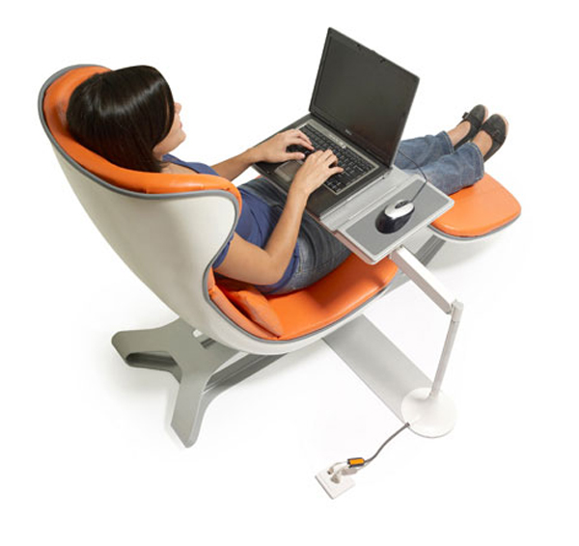
higher Design & Manufacture
Ergonomics

Slide 2
Learning intentions & success criteria
Learning Intentions
Introduction to the ergonomics design factor.
Success Criteria
Gain an understanding of ergonomics.
Explain the three different sub-categories of ergonomics.
Use your knowledge to inform your design work.

Slide 3
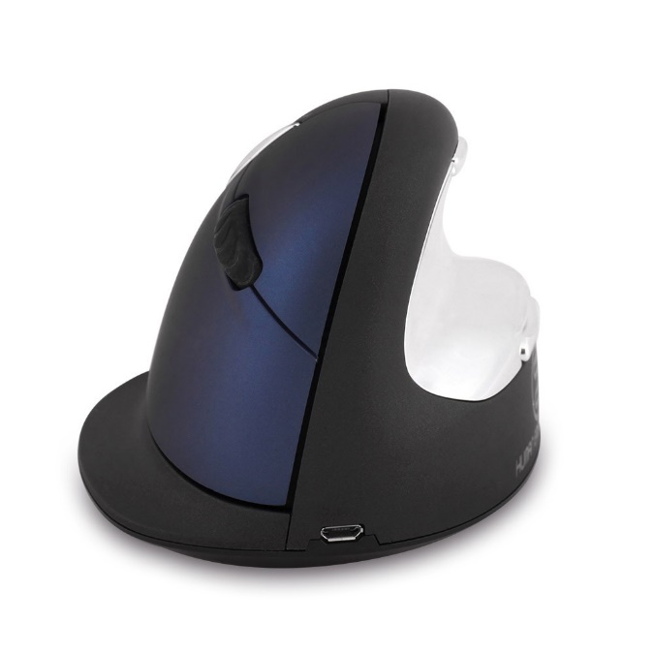
What is ergonomics?
Ergonomics is:
The study to improve interactions between people and their products or environment.
This is to make it:
Easier to use
Less frustrating to use
More comfortable to use
Safer to carry

Slide 4
example
Consider how ergonomics would impact the design of a vacuum cleaner:
Should be comfortable to use by a range of users
Height should adjust to suit users
Handle size should allow big and small hands to hold it comfortably
The noise should be tolerable
Buttons and switches should be easy to press with fingers and/or feet
There should be easy access to the buttons and switches
They should operate with reasonable force or effort.

Slide 5
Case study: dyson vacuum
Attachments should be easy to store, remove from their positions, fit and use
Required action should be clear
Force and effort required should be within reasonable limits
There should be adequate clearance for access
Colours and textures should be used to identify, remove, fit and use functional parts
User needs to know when the vacuum is turned on or off, there should be a visual/audible cue
User should be able to use the vacuum without injury or strain
Weight should be reasonable for normal strength
Should be easy to turn and manoeuvre with minimal strain/effort

Slide 6
Ergonomic word bank
Reach
Clearance
Strength
Force
Effort
Sound
Smell
Texture
Taste
Vibration
Movement
Size
Grip
Weight
Response
Proximity
Fatigue
Strain
Safety

Slide 7
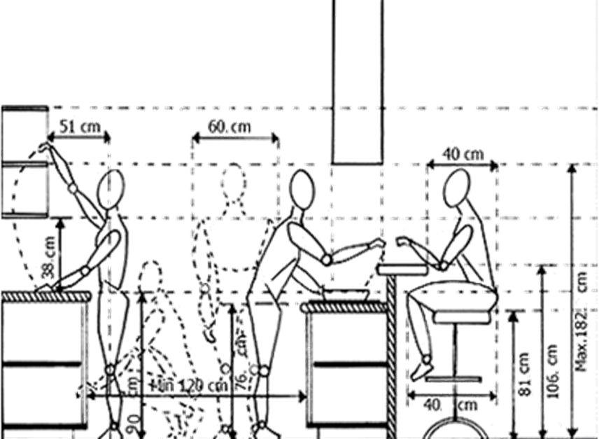
Ergonomic categories
Ergonomics is a huge area of study that is commonly broken down into the following sub-topics:
Anthropometrics
Physiology
Psychology

Slide 8
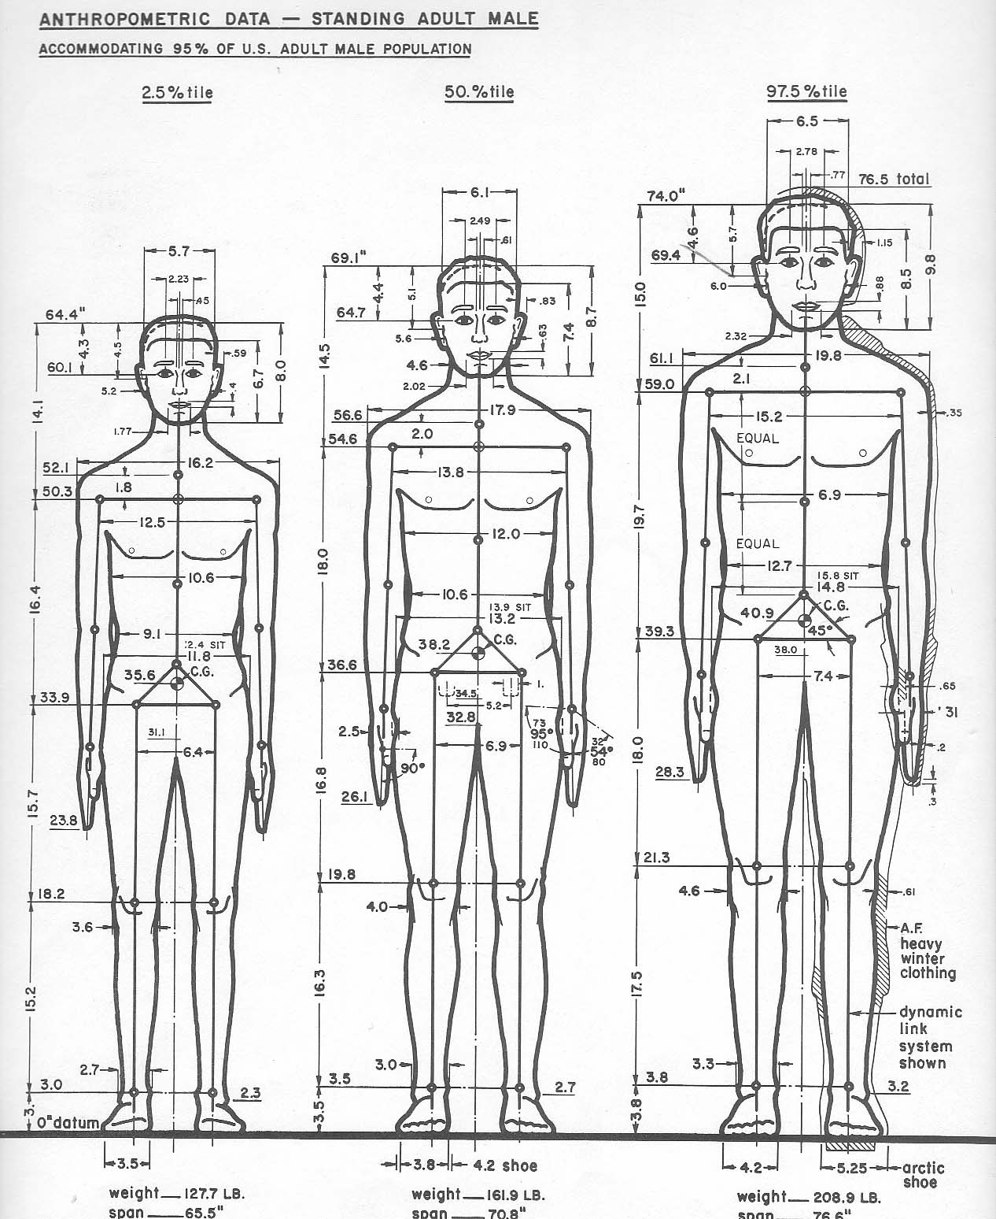
anthropometrics
Knowing and understanding physical measurement and limitations of a person’s size and form is essential if a product or space is to have good ergonomic design.
Designers must ensure it is sufficient to access, or the space between components to allow easy, safe and comfortable use.
This is the anthropometric aspect of ergonomics.

Slide 9
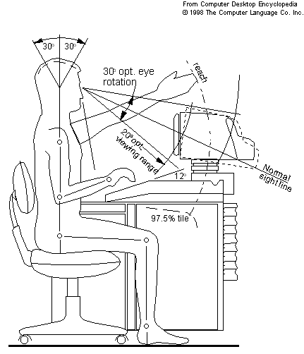
Applying anthropometrics
First, a designer must gather relevant data
This ensures they can accommodate for a full range of intended users of the product or space
They must identify things such as age, gender, ethnicity etc.
This information is essential to ensure the majority of users have suitable reach, clearance and range of movement to be able to use the product easily and safely.
A designer can obtain anthropometric data by measuring the relevant sizes of a sample of people.

Slide 10
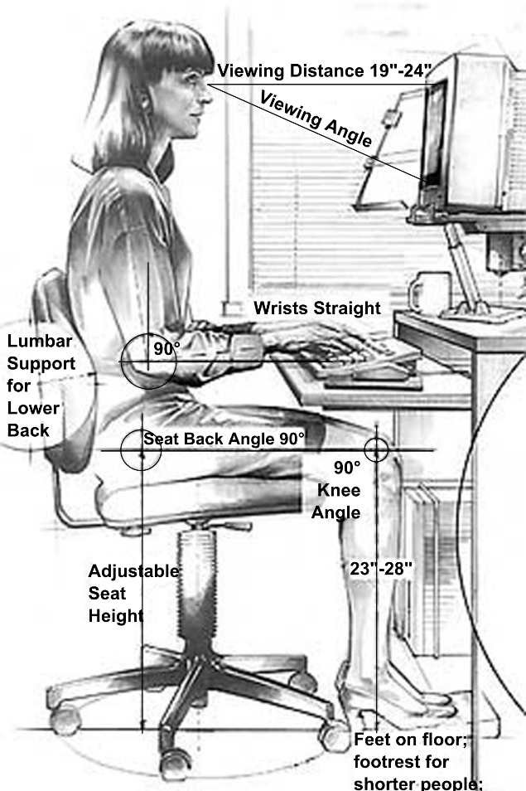
anthropometrics
We use anthropometrics because we want to design products that are suitable for the largest number of users.
We use percentiles to help decide what sizes to use.

Slide 11
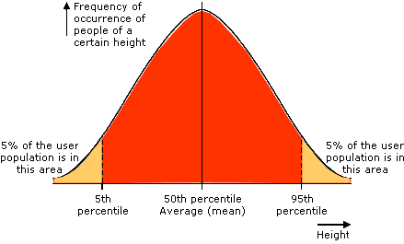
Applying anthropometrics
Humans differ in size considerably.
When plotted on a graph, the frequency of the range of sizes from smallest to largest result in a distribution which produces a bell curve as shown below.

Slide 12
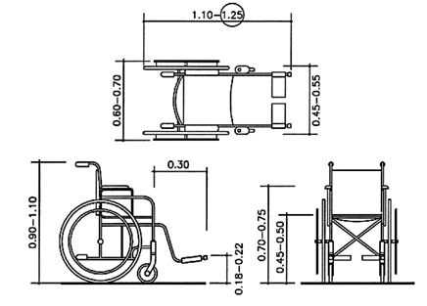
anthropometrics
For example, a door’s height must include the 95th percentile, otherwise taller people would be disadvantaged. The door’s width is determined by access for disabled people with wheelchairs.
In contrast, a chair’s seat height from the floor would be designed for the 50th percentile to ensure most people can sit comfortably and rest their feet on the floor.

Slide 13
anthropometrics
Anthropometric Considerations:
Intended users
Range of sizes
Data tables
Appropriate percentages
Inclusive design
Age
Gender
Ethnicity
Situation

Slide 14
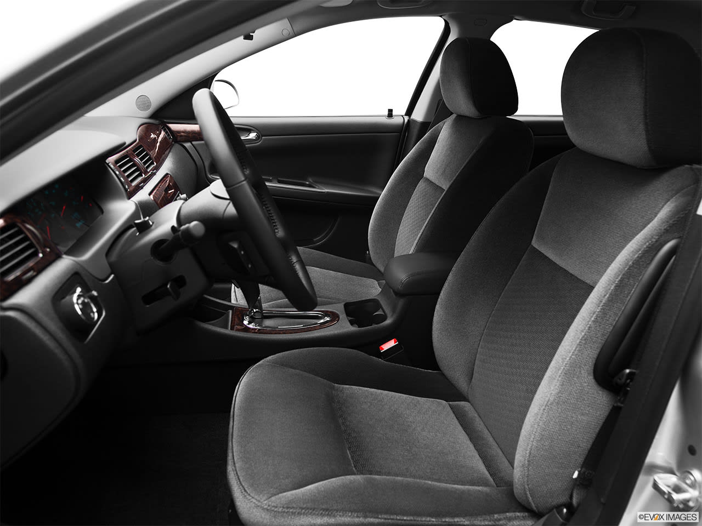
What anthropometric data would need to be considered when designing a driver’s seat in a car?

Slide 15
Eye line for mirrors and windows
Elbow rest
Steering wheel diameter and thickness
Distance from steering wheel
Height and width of head rest
Distance to reach stalks and other buttons
Width and height of back
Height of the seat from footwell
Distance from the pedals
Width of seat

Slide 16
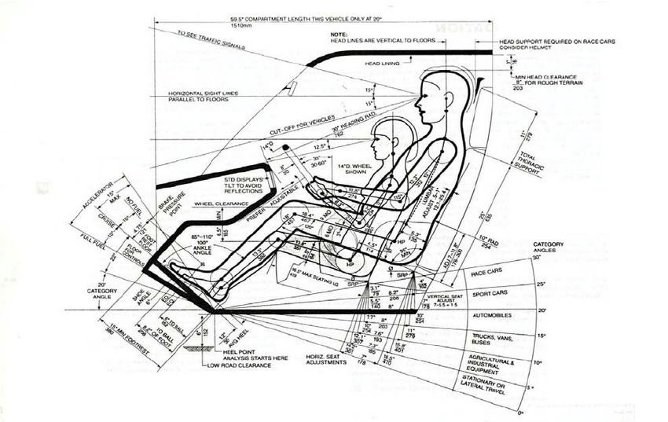
Example of driver’s seat ergonomic considerations.
The driver’s seat in particular requires a large number of adjustable parts in order to accommodate people of all shapes, sizes and reach capabilities.

Slide 17
physiology
A well-designed product only requires reasonable strain or effort from the user.
Any product that requires high levels of force to operate it will result in user fatigue, strain or injury, especially if used repeatedly or for long periods of time.
This does not necessarily mean products should be designed to be easily used in all their aspects: some products require some force to operate to prevent them being switched on or used by accident.
Designers must consider how different parts of the human body work and interact with a product.

Slide 18
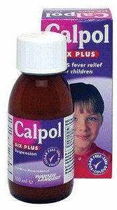
Applying physiology
Physiology is focused upon specific characteristics and mechanisms of the human body, such as:
Range of movement
Fatigue
Strength
A common mistake is to design products to be as light or a easy to use as possible.
For example: a medicine bottle shouldn’t be too easy for children to understand and open but not too difficult for a fully grown adult.

Slide 19
Applying physiology
You must understand the limitations and needs of the user
Some considerations you might want to remember:
Range of movement
Type of movement
Strength
Effort
Fatigue or strain
Physical limitations
Coordination
Inclusive design
Reaction time

Slide 20
psychology
A product with good ergonomic design should be intuitive to use.
The way a product looks, feels, sounds, smells and even tastes can affect the experience of the product.
These feelings and perceptions are powerful psychological aspects of ergonomics.

Slide 21
Applying psychology
Psychology is the mental process such as perception and memory
These processes are influences by how something looks, feels, sounds, smells and tastes.
Understanding how users behave and react in different situations is important for good user-centres design.
This will prevent feelings of failure or frustration when users don’t understand how to use a product or system

Slide 22
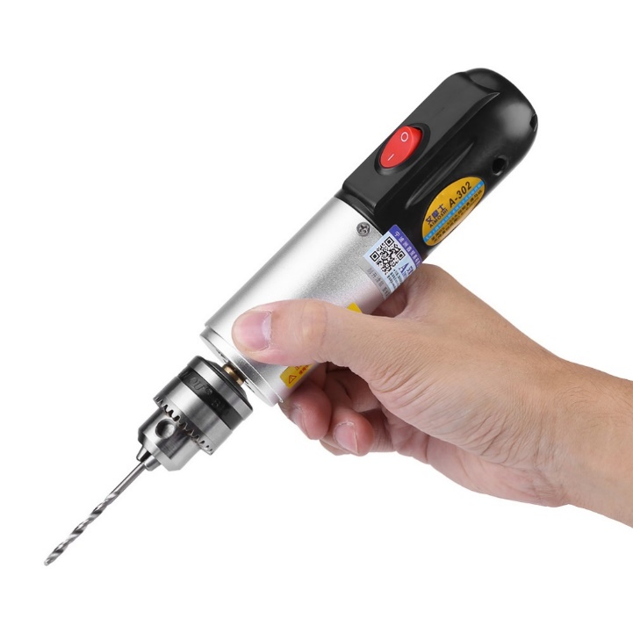
Applying psychology
User-centred design should make it easy for the user to:
Determine what actions can be carried out
Understand the results of their actual and potential actions
Evaluate the current state of the product
Interact naturally with the product’s or system’s layout

Slide 23
Applying psychology
The user needs to be able to carry out the intended operation with ease. Designers should:
Avoid overcomplicating products with unnecessary features
Ensure it is intuitive to use
Ensure the location of functions and mode of use are clear
Ensure each action is confirmed by feedback from the product
Design to mitigate user error

Slide 24
PAST PAPER QUESTION
Successful products require careful consideration of ergonomics.
Explain why ergonomics has influenced the design of products that you are familiar with.
(You may refer to more than one product in your answer.)
(To attract full marks you must include the influence of all three areas of ergonomics in your answer.)
(8 marks)
You must write 8 different points.

Slide 25
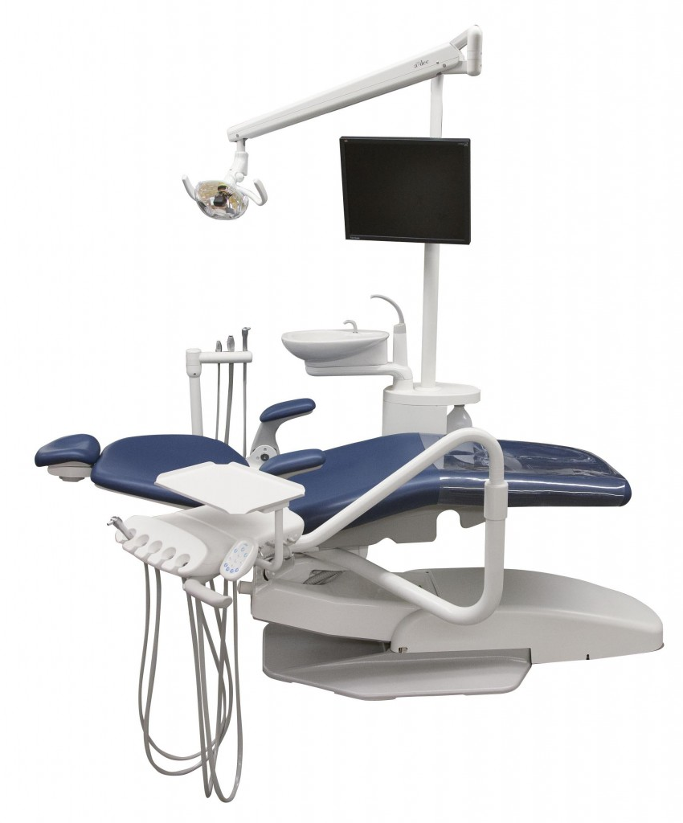
Task 1
The dental chair here is designed with two different users in mind: the dentist and the patient
Consider what is required to ensure a dental chair is safe, easy and comfortable to use.
Think about your experience at the dentist. Consider what is required to ensure a dental chair is safe, easy and comfortable to use for the patient.
Analyse the dental chair using the same method as the vacuum cleaner example.
Detail how ergonomics could impact the design of the dental chair for the dentist and the patient.
Use the ergonomic word bank to help you answer the question.

Slide 26
TASK 1 ANSWERS
Position of the bowl should be easy to reach for both tall and short users
Dentist must be able to reach and move with ease
Height and shoulder width should be considered to ensure seat is suitable for larger patients. This will help them feel at ease.
The sitting eye level of the dentist should be considered to ensure the patient can be moved to a suitable height
Chair movement should be slow and steady as not to startle the patient
Hand sizes should be considered to ensure sufficient access to grip, remove and replace tools with minimum effort. The dentist should appear at ease to keep the patient calm.
Colours should calm the patient and look sterile and clean
Noise from tools should be quiet so as not to frighten the patient, but loud enough for the dentist to recognise they are on

Slide 27
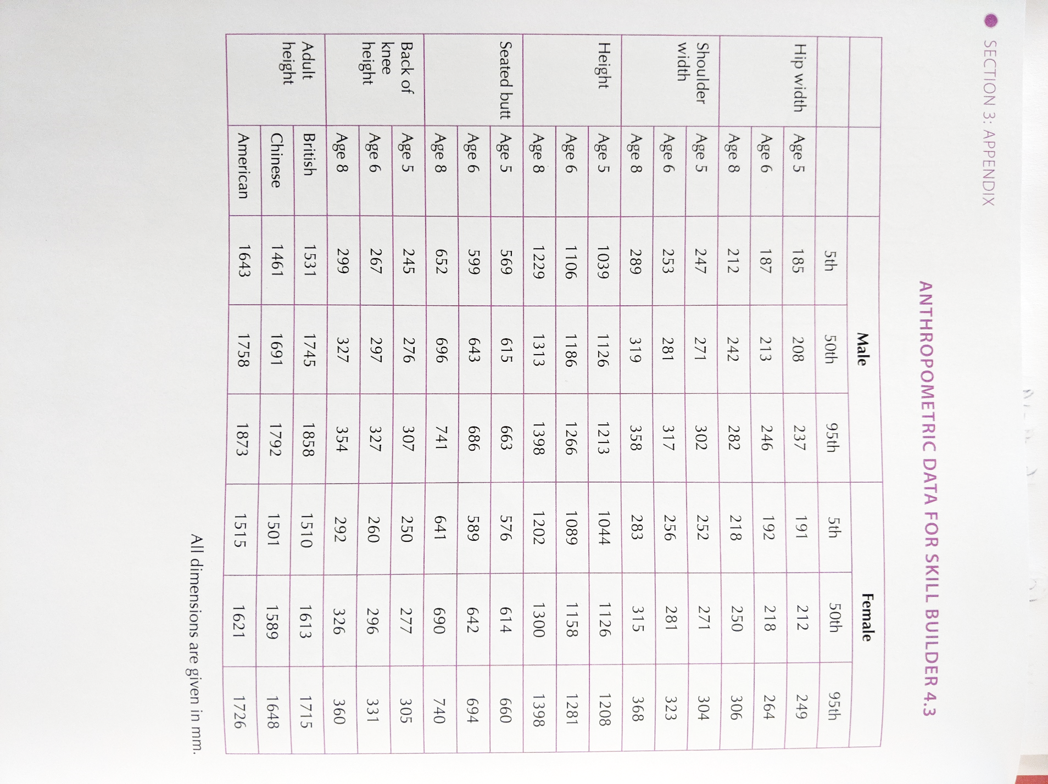
Task 2
Designers may make allowances for variables, like outdoor clothing, when selecting appropriate sizes.
With this in mind, use the data in the table below to select the minimum sizes for the following areas of the children’s playground. Justify your selection.
Diameter of the flume – to fit all children sliding
Width of the red slide – up to age 5
Height of the red roof up to age 6 – children standing
Height of opening to flume slide – all children sitting
Height of swing frame to allow all adults clearance
Height of the swing seat – allow all children to sit safely

Slide 28
Ergonomics Task 2 Answer
Diameter of the flume – to fit all children sliding
368mm – age 8 girl 95th percentile shoulder width
Width of the red slide – up to age 5
249mm – age 5 boy 95th percentile
Height of the red roof up to age 6 – children standing
1281 – age 6 girl 95th percentile height
Height of opening to flume slide – all children sitting
741mm – age 8 boy 95th percentile seated butt to head
Height of swing frame to allow all adults clearance
1873 – American adult male 95th percentile height
Height of the swing seat – allow all children to sit safely
245mm – age 5 boy 5th percentile back of knee height

